Slide 1



Using Synthetic Aperture Radar And Deep Learning For UXO Detection
Michael Prihoda
Center for Geographic Information Science, University of Maryland
GEOG 797 Capstone
Jonathan Hathaway
Fall 2023

Slide 2
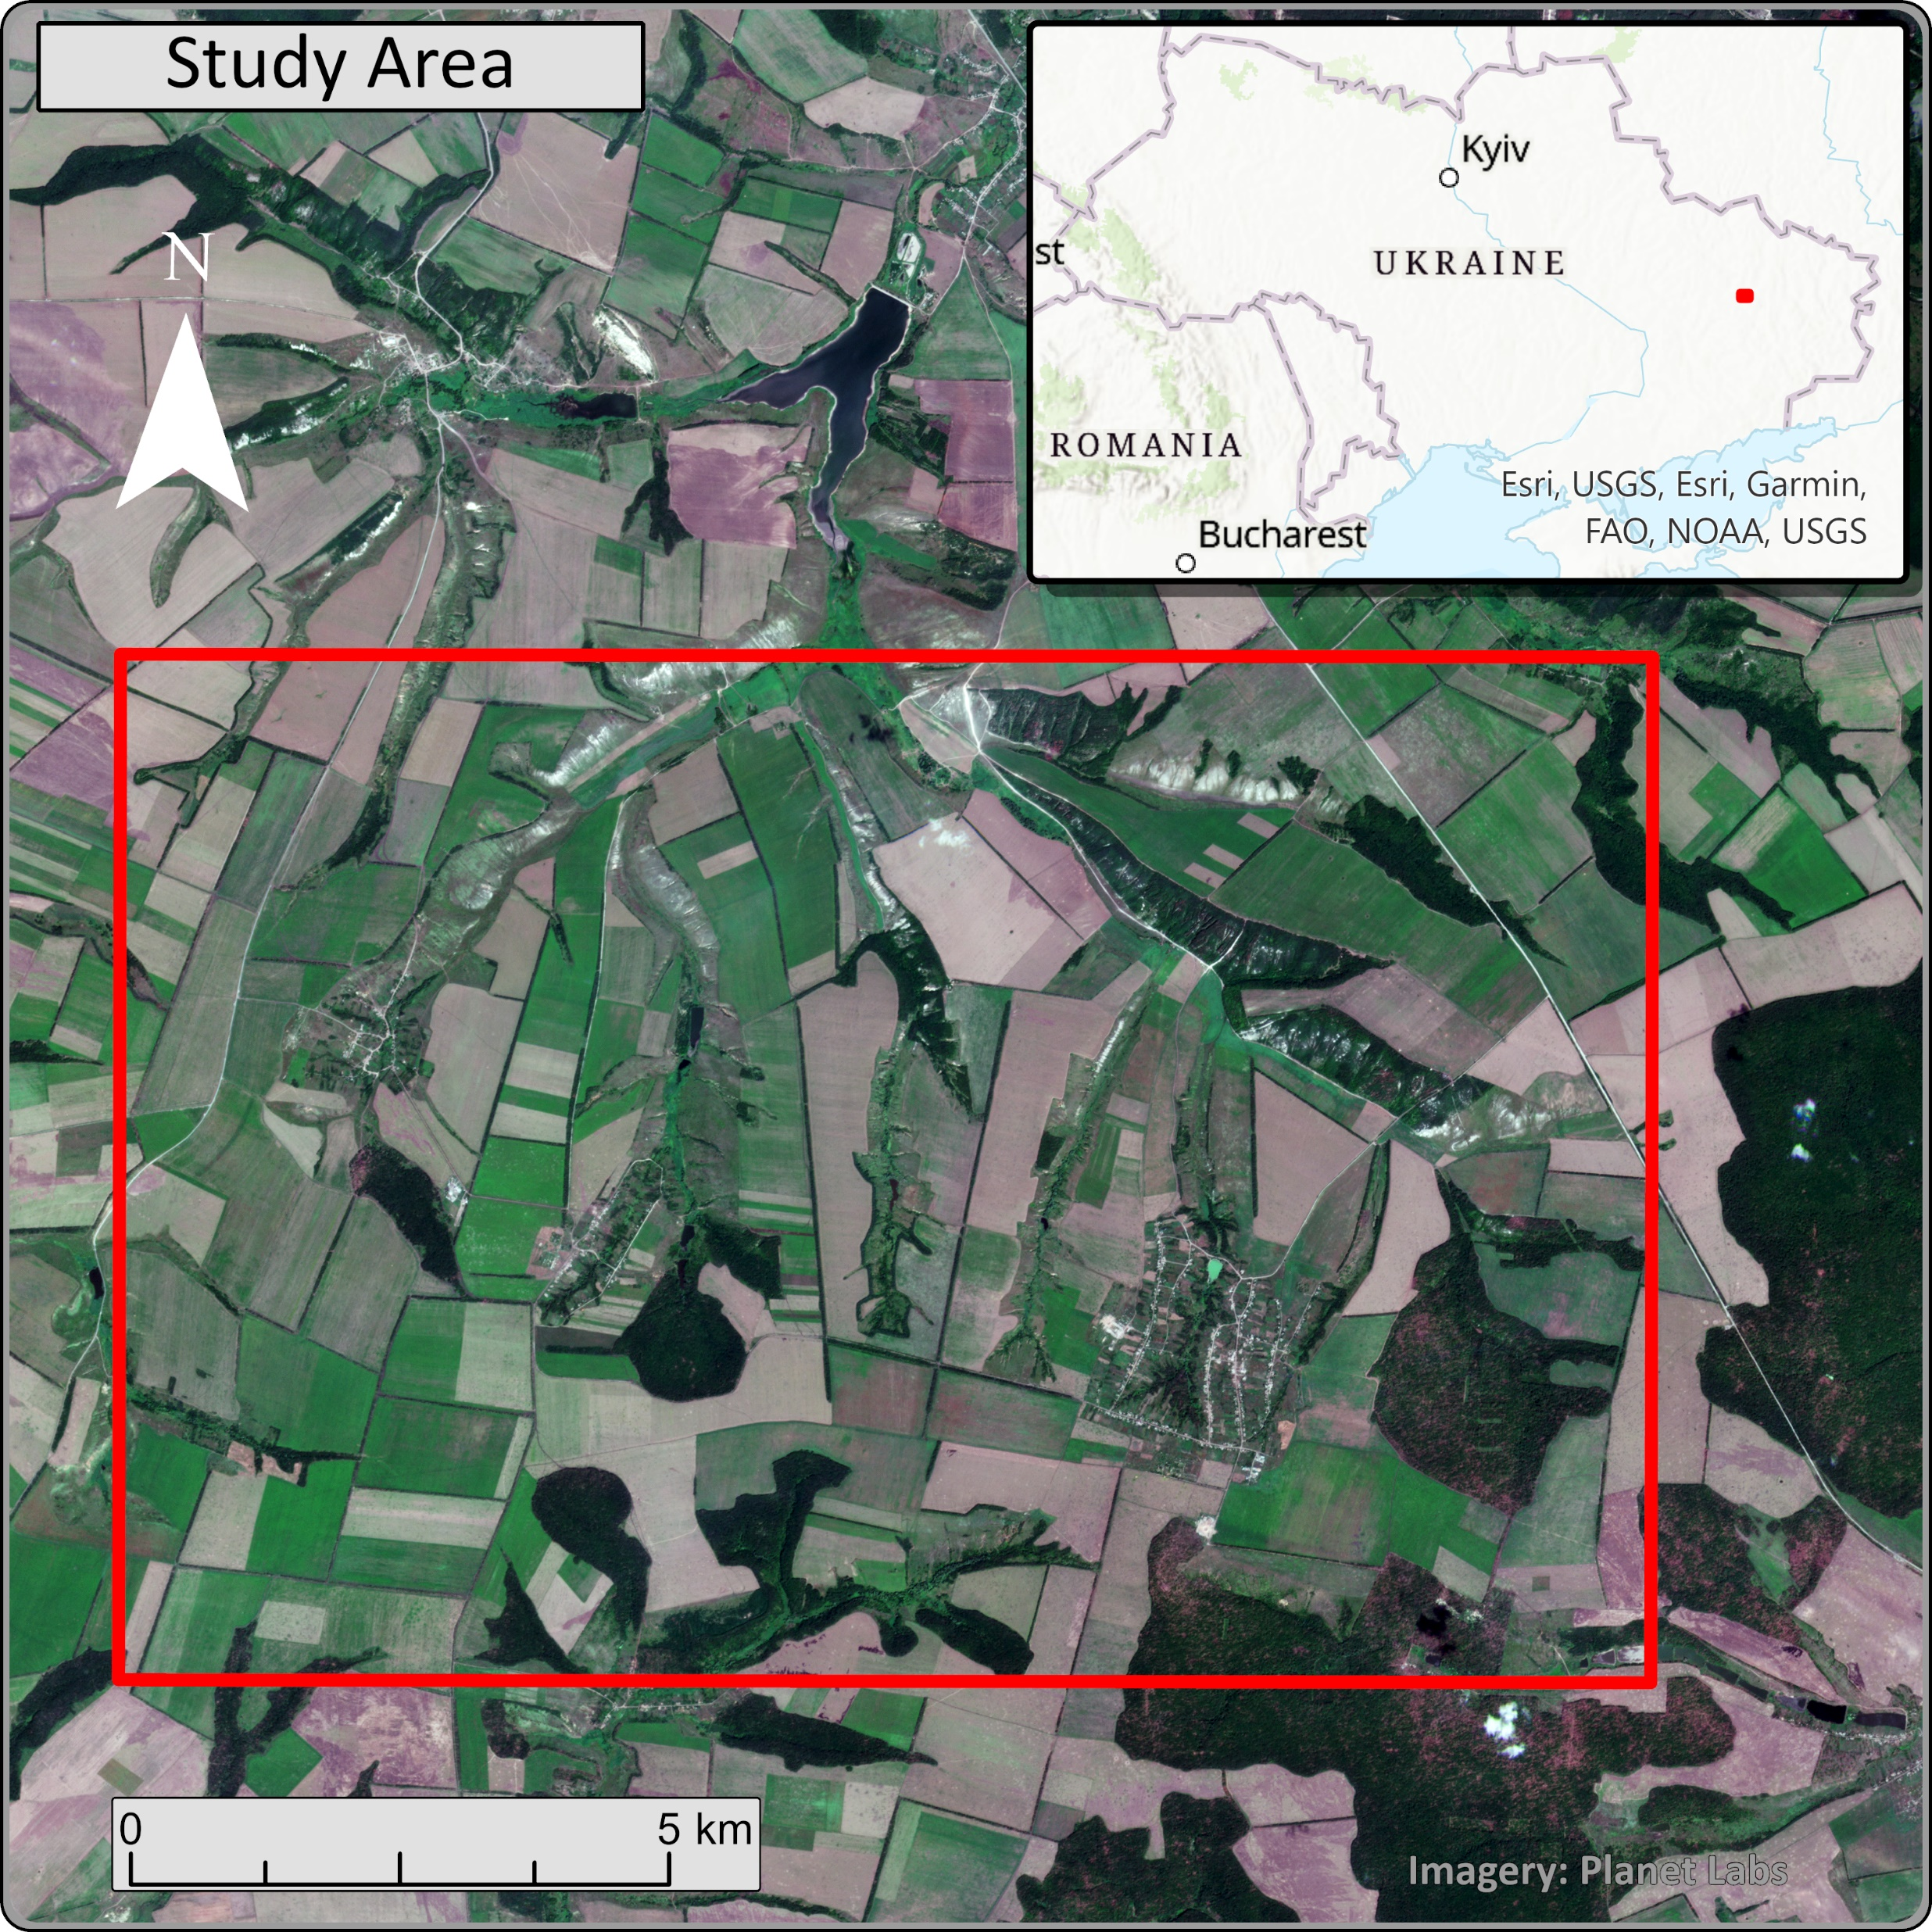
Introduction
In the summer of 2022 artillery exchange between Ukraine and Russia was between 30,000-60,000 shells per day combined
Brazhkivka, Sulyhivka, and Dovhenke were the frontlines for months and subject to relentless shelling
Each shell has a rate of failure, and unexploded shells embed in soil where they land, creating UXO risks
Deep learning and SAR imagery present a way to identify areas where higher concentrations of unexploded ordnance may be present
Notes:
Joseph Stalin called artillery the “god of war” and while that might not apply to all conflicts, it certainly applies to the ongoing war in Ukraine. On average, Ukraine and Russia expend tens of thousands of shells per day along a 1,000km line of contact. That’s millions over the course of a year. These munitions aren’t perfect, each shell or rocket fired carries some risk of failure. As an extreme example, in 2010 North Korea attacked a South Korean island with artillery; 20% of the shells fired failed to detonate. If shells fail to detonate, they’re still packed with explosives and become UXO; something like plowing fields could detonate hidden UXO so they’re a hazard.
UXO is often found in the proximity of munitions that did explode, evidenced by the presence of blast craters, this simple idea is used to narrow the search even today for UXO from World War I.

Slide 3
Objectives
Establish that SAR imagery, particularly single-band pre-processed products, can be used in deep learning for a crater detection task.
Build a custom U-Net model in PyTorch for the binary segmentation task and evaluate this model in comparison to pre-trained models.
Use the outputs of binary segmentation to reveal areas where UXO hazards are more likely to be present.
Notes:
Joseph Stalin called artillery the “god of war” and while that might not apply to all conflicts, it certainly applies to the ongoing war in Ukraine. On average, Ukraine and Russia expend tens of thousands of shells per day along a 1,000km line of contact. That’s millions over the course of a year. These munitions aren’t perfect, each shell or rocket fired carries some risk of failure. As an extreme example, in 2010 North Korea attacked a South Korean island with artillery; 20% of the shells fired failed to detonate. If shells fail to detonate, they’re still packed with explosives and become UXO; something like plowing fields could detonate hidden UXO so they’re a hazard.
UXO is often found in the proximity of munitions that did explode, evidenced by the presence of blast craters, this simple idea is used to narrow the search even today for UXO from World War I.

Slide 4

Data
X-band SAR imagery accessed through Capella Space’s Data Cooperative program
GEO product
0.5m ground sample distance
Multi-looked
Terrain-corrected
Single-band raster of backscatter intensity value
2 images from ascending orbit, 1 from descending orbit
30-40 degree look angle
Notes:
I applied to Capella Space’s data cooperative program and gained access to their archival imagery. Coverage is not total, but suitable scenes were identified from the summer of 2022 along the Kharkiv/Donetsk border. The imagery has 0.35m cell spacing and 0.5m ground sample distance, and is terrain corrected HH SAR X-Band. It’s worth mentioning the look angles and orbits were not the same for each image resulting in varied appearance in images; despite the same satellite collecting all three scenes.

Slide 5
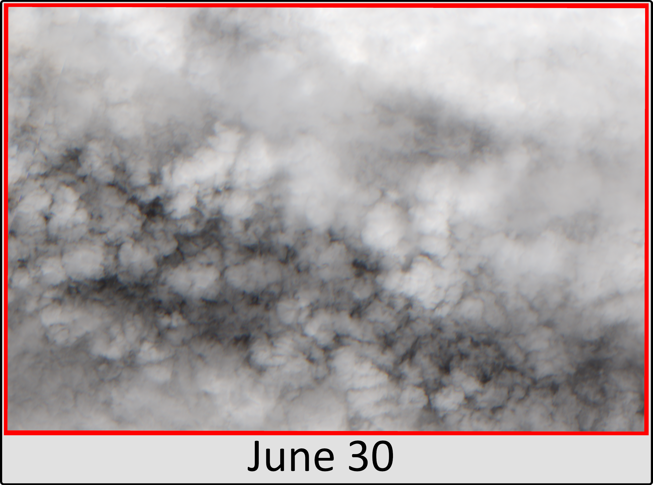
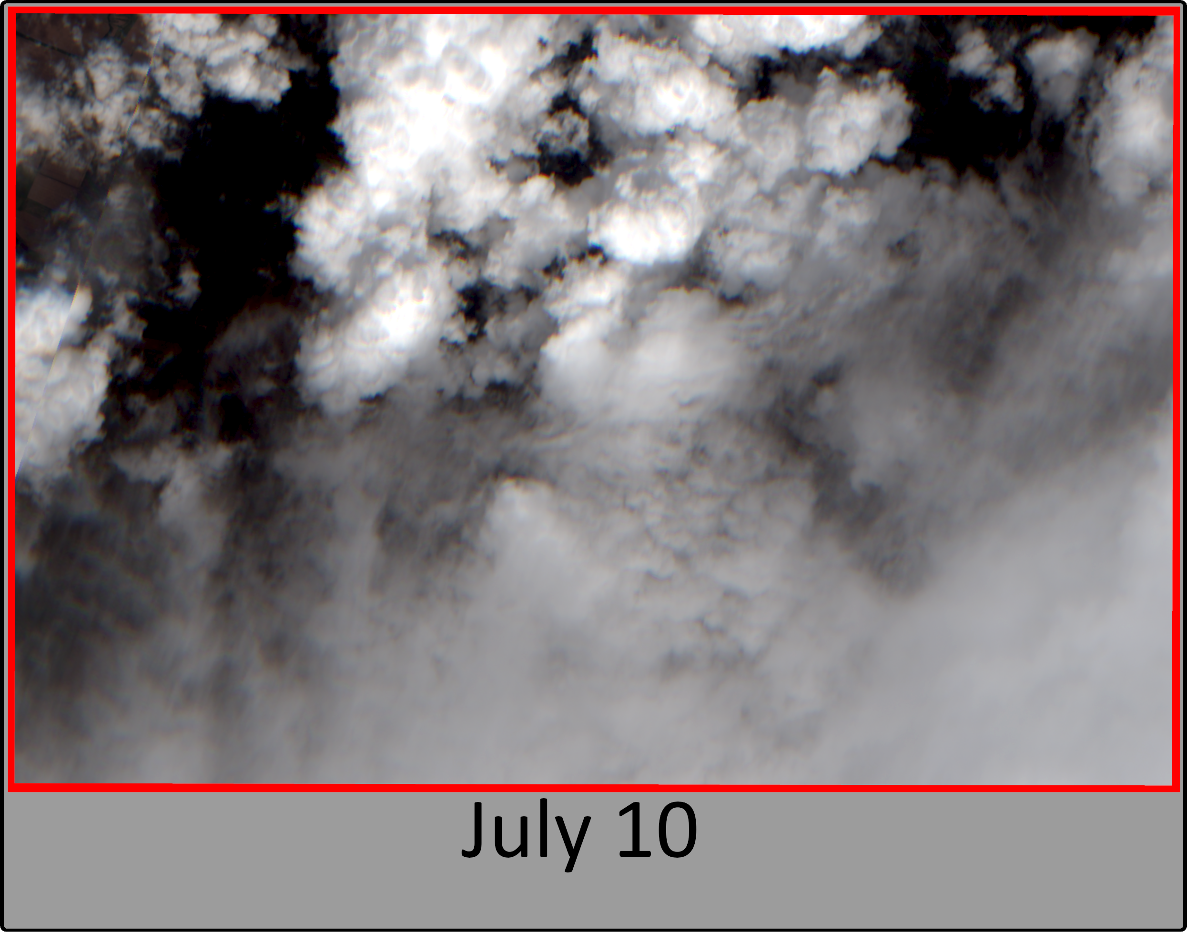
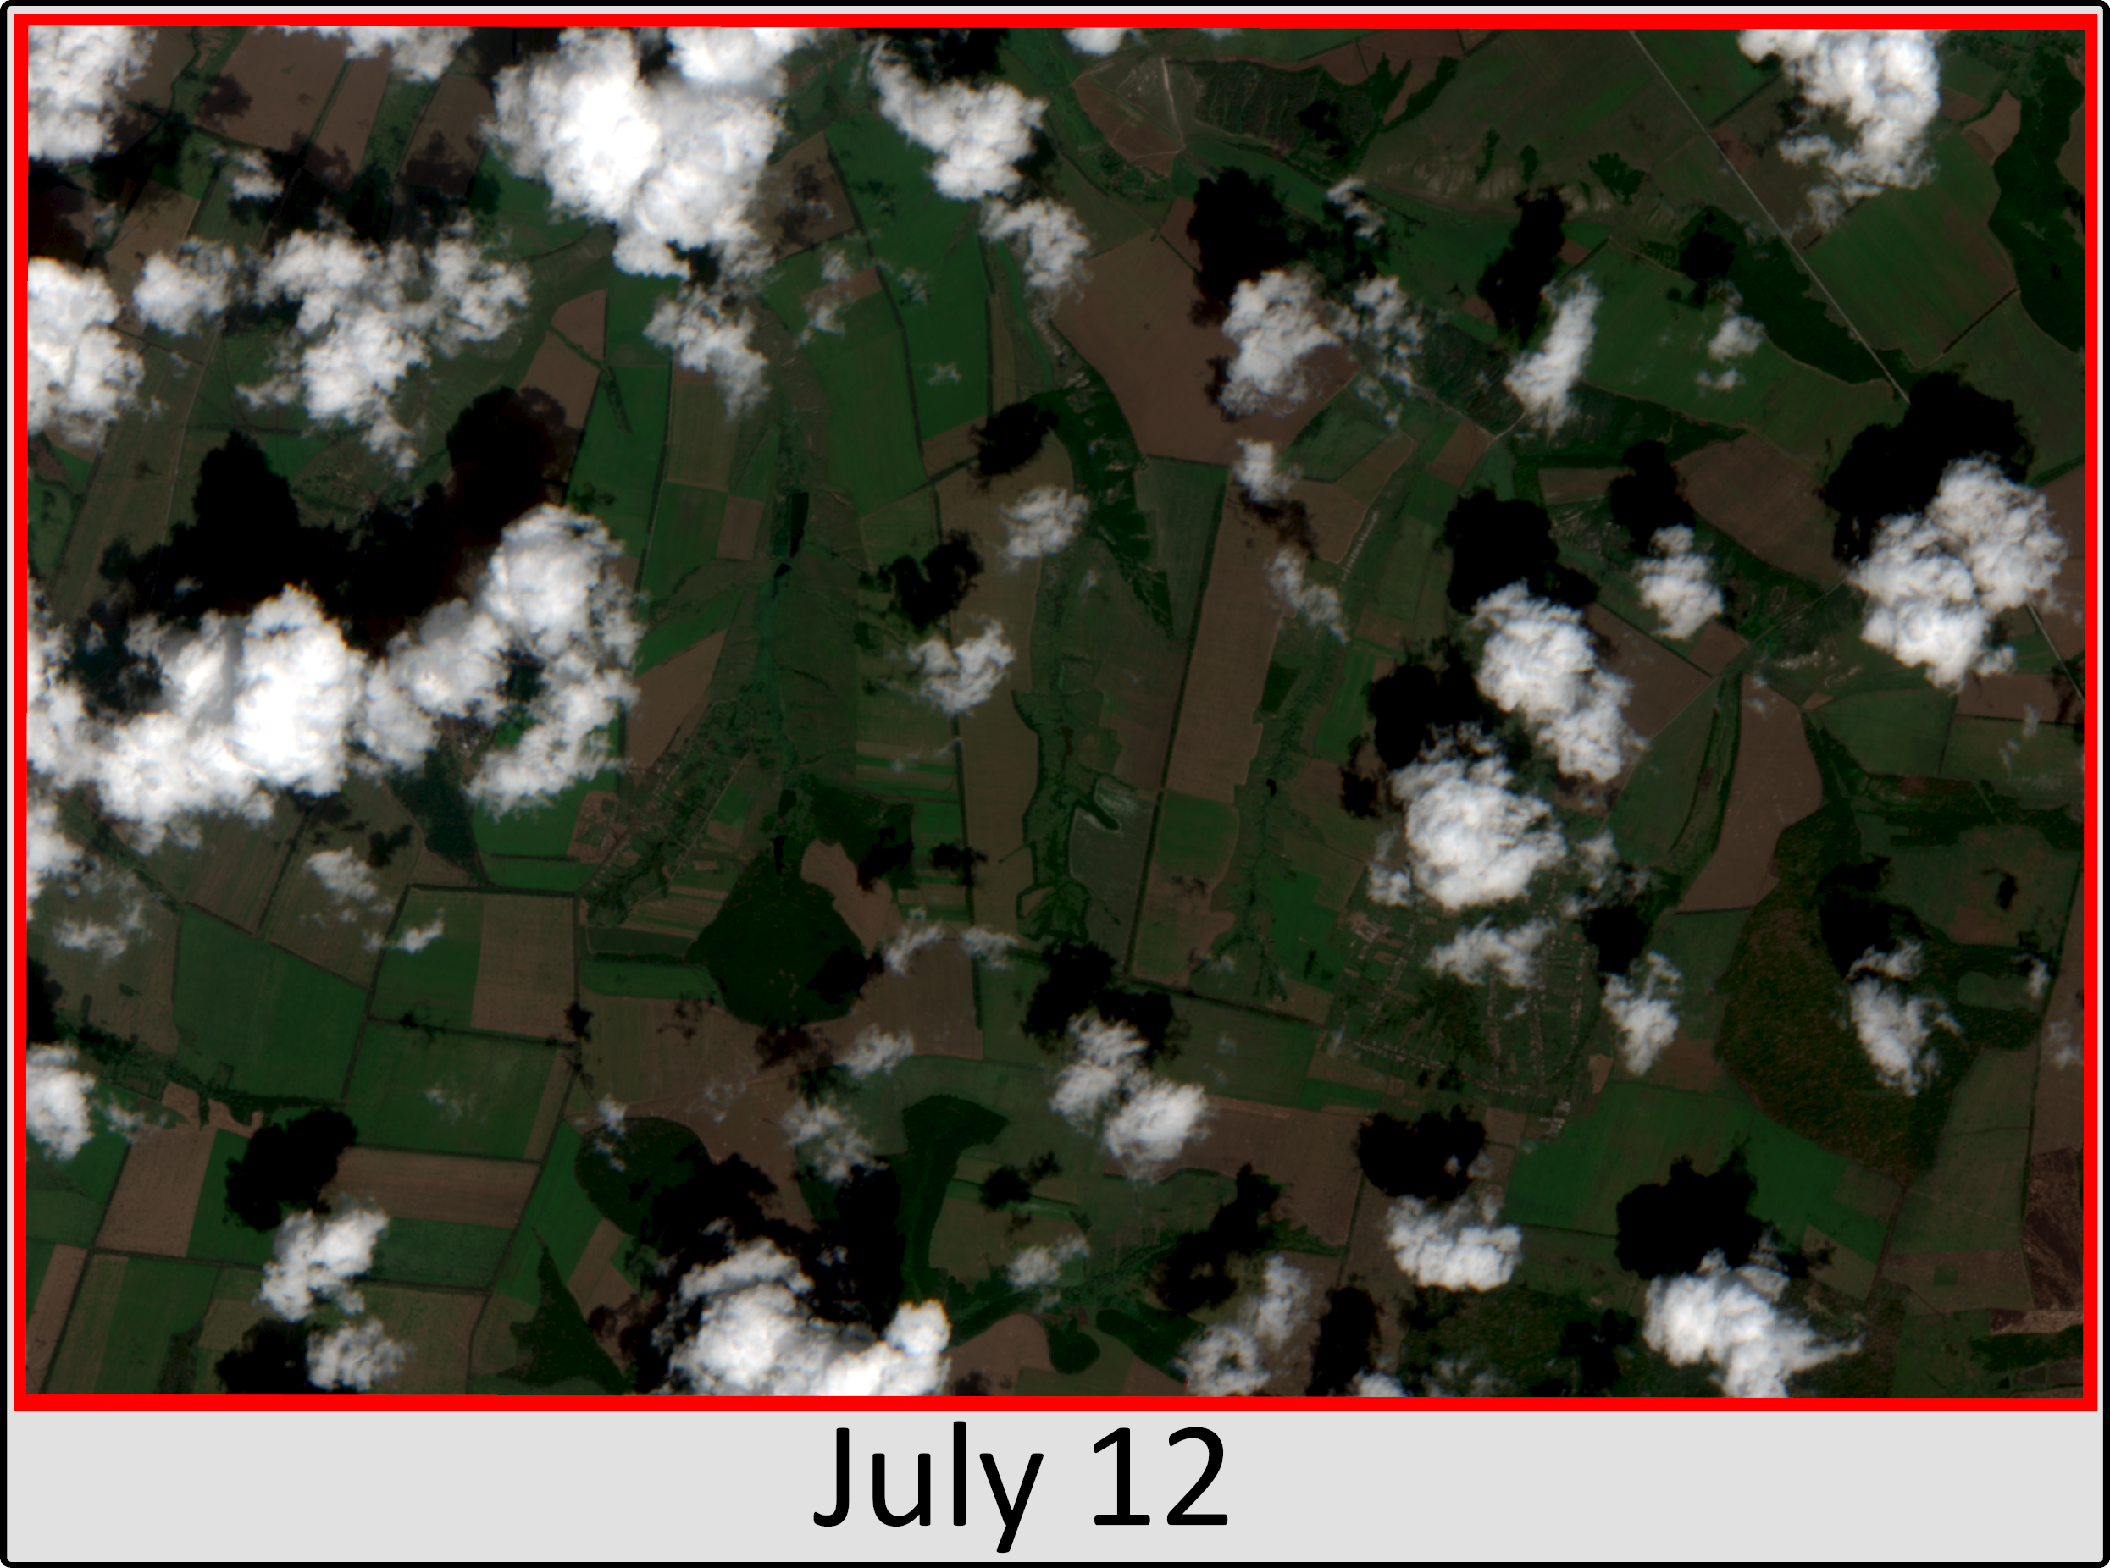
Data
SAR allows greater consistency in collections, not at the mercy of the environment nor limited to only daylight hours.
Sentinel 2 imagery was mostly obstructed by cloud cover during the period of interest.
Notes:
A big advantage of SAR is it works at any time and with any weather; the same can’t be said of optical imagery.

Slide 6



Methods
Esri Deep Learning Libraries
Training data collection ~3,000 total from 20 square km
Establish that deep learning algorithms can create a useful output from SAR imagery using pre-trained models in a U-Net architecture
Provide benchmarks for comparison
Pytorch & Pytorch Lightning
Build a custom model to test the effectiveness of changing additional parameters and model layers; modifications at this level are not accessible in Esri deep learning libraries
+
Notes:
Esri deep learning libraries provided some convenient tools, especially for training data collection. Over 3,000 craters were collected in the approximately 20Additionally, the libraries allowed fine-tuning of pretrained models. These served to establish that deep learning models could learn from single-band SAR in place of the usual three-band/channel input imagery.
These tools are limited in the ways they can be configured for better performance at a task. To have more freedom to specialize a model, I built a one using PyTorch and PyTorch Lightning, experimenting with the model and its components was deeper than changing learning rates.

Slide 7
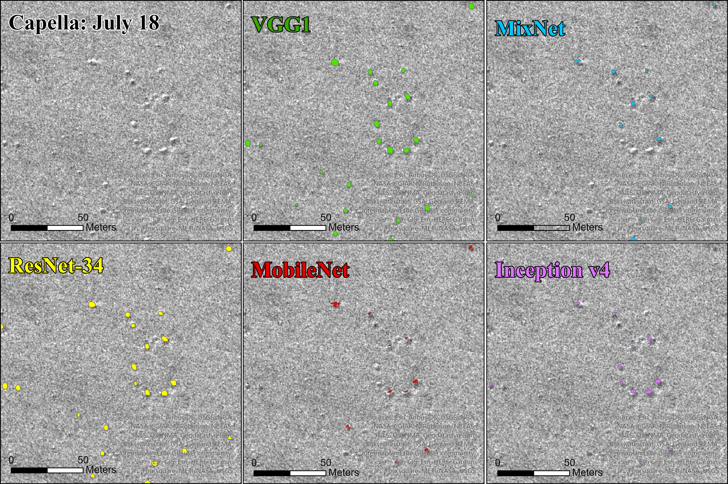
Results
Recall: number of detected craters out of all true positives present (as indicated by label)
Precision: how often what is detected as crater is truly a crater
F1: harmonic mean of recall and precision
Notes:
Recall is how many of the labeled craters the model detected, precision is how often the model is right when it calls something a crater.
Mine got the highest recall… at the expense of precision which it scored the worst at. It makes classifications of the positive class more often, but makes a lot of false detections at the same time.

Slide 8
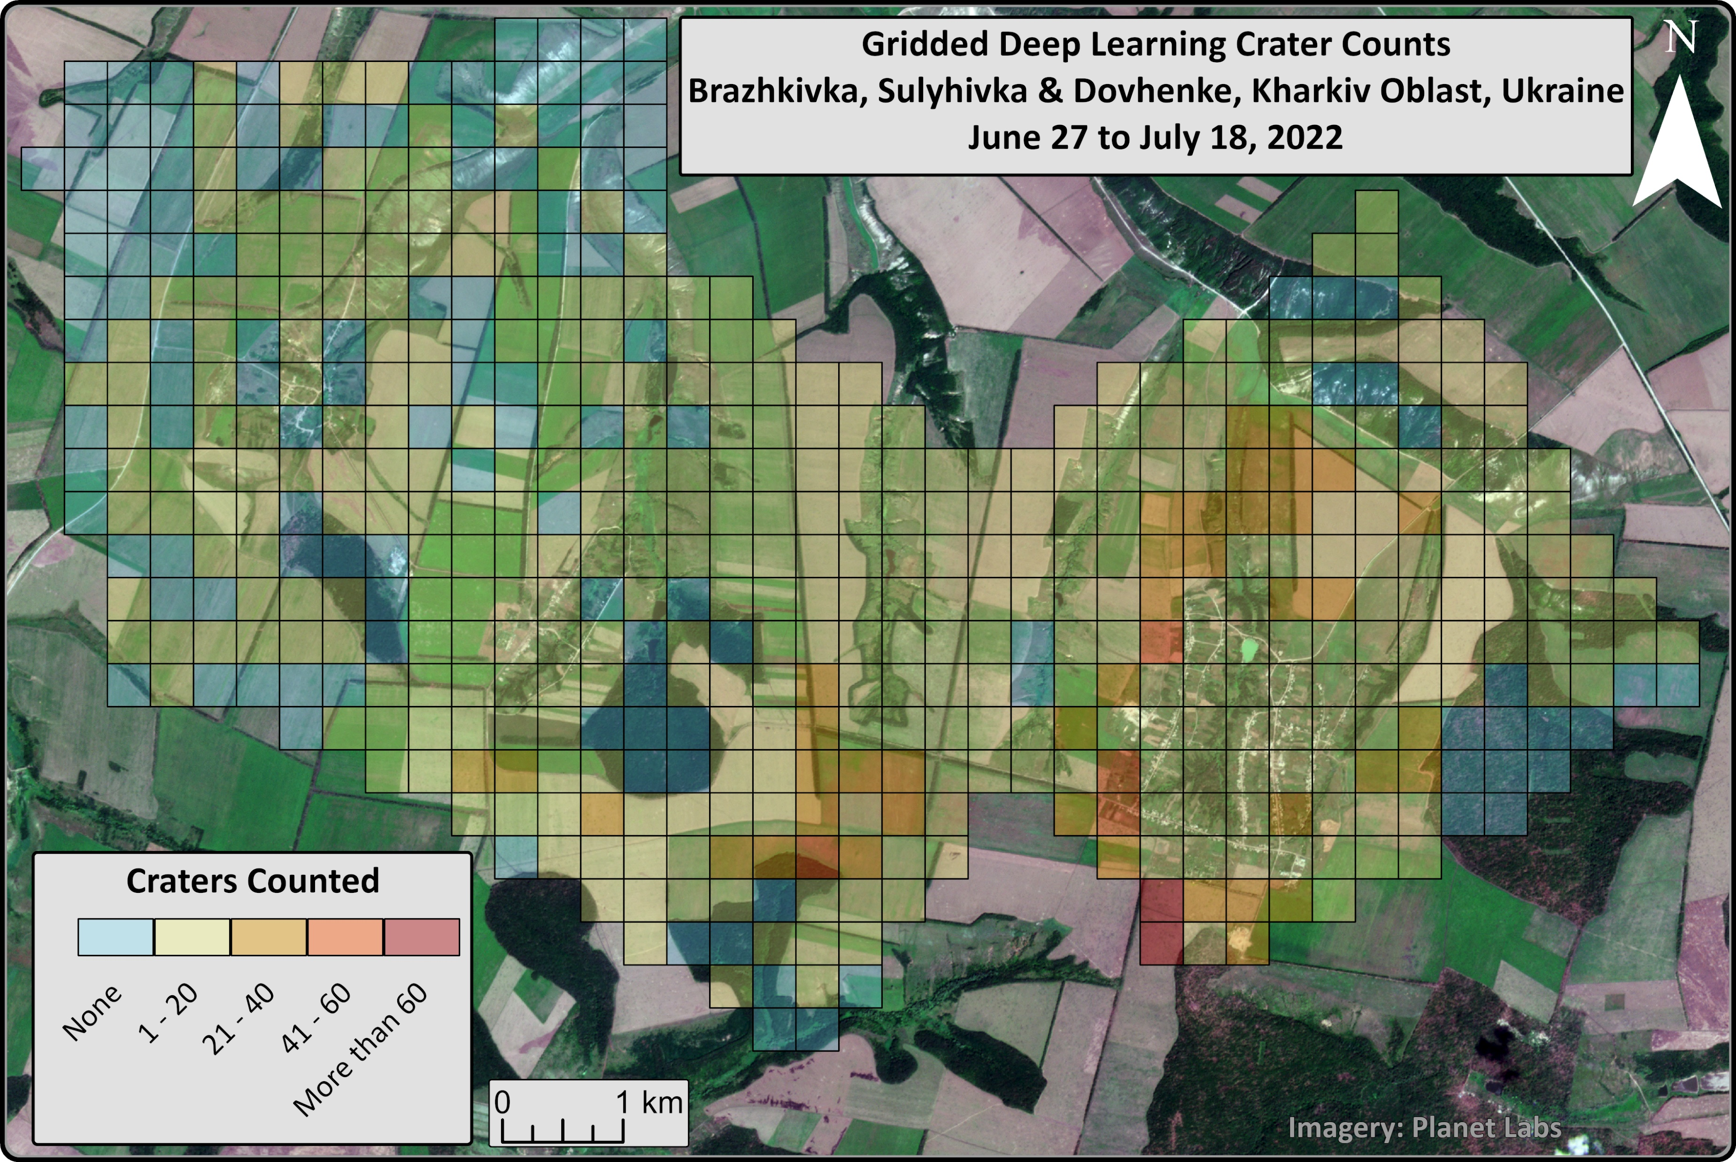
Results
Crater counts provide a basic sense of artillery concentration and as a result where UXO is more likely to be present.
Seeing some blue (no craters) is a good sign a model isn’t overclassifying in general.

Slide 9
Conclusion
Models show undercounting of craters present, may be improved by further model tweaks and additional training data.
SAR imagery can be used in similar ways to multiband data for crater detection through deep learning.
Very high resolution SAR imagery may provide useful alternatives to multispectral/optical data is unavailable for an area of interest.
Binary segmentation of SAR imagery has applications beyond crater detection; as the constellations of Capella, ICEYE, Umbra, etc. grow, so does the number of applications

Slide 10
References
Anwar, T., & Zakir, S. (2021). Effect of Image Augmentation on ECG Image Classification using Deep Learning. 2021 International Conference on Artificial Intelligence (ICAI), 182–186. https://doi.org/10.1109/ICAI52203.2021.9445258
Byholm, B. (n.d.). Remote Sensing of World War II Era Unexploded Bombs Using Object-Based Image Analysis and Multi-Temporal Datasets: A Case Study of the Fort Myers Bombing and Gunnery Range [M.S., Minnesota State University, Mankato]. Retrieved October 22, 2023, from https://www.proquest.com/docview/1916044230/abstract/57802EA8A9684946PQ/1
Chen, S., & Zhang, B. (2022). RSUnet: A New Full-scale Unet for Semantic Segmentation of Remote Sensing Images [Preprint]. In Review. https://doi.org/10.21203/rs.3.rs-1211375/v1
Clark, M., Barros, G., & Stepanenko, K. (2022, April 6). Russian Offensive Campaign Assessment, April 6. Institute of the Study of War. https://www.understandingwar.org/backgrounder/russian-offensive-campaign-assessment-april-6
Diakogiannis, F. I., Waldner, F., Caccetta, P., & Wu, C. (2020). ResUNet-a: A deep learning framework for semantic segmentation of remotely sensed data. ISPRS Journal of Photogrammetry and Remote Sensing, 162, 94–114. https://doi.org/10.1016/j.isprsjprs.2020.01.013
Duncan, E. C., Skakun, S., Kariryaa, A., & Prishchepov, A. V. (2023). Detection and mapping of artillery craters with very high spatial resolution satellite imagery and deep learning. Science of Remote Sensing, 7, 100092. https://doi.org/10.1016/j.srs.2023.100092
Erickson, B. J., & Kitamura, F. (2021). Magician’s Corner: 9. Performance Metrics for Machine Learning Models. Radiology: Artificial Intelligence, 3(3), e200126. https://doi.org/10.1148/ryai.2021200126
Fan, X., Yan, C., Fan, J., & Wang, N. (2022). Improved U-Net Remote Sensing Classification Algorithm Fusing Attention and Multiscale Features. Remote Sensing, 14(15), Article 15. https://doi.org/10.3390/rs14153591
Ferrer, L. (2023). Analysis and Comparison of Classification Metrics (arXiv:2209.05355). arXiv. http://arxiv.org/abs/2209.05355
Gholamy, A., Kreinovich, V., & Kosheleva, O. (2018). Why 70/30 or 80/20 Relation Between Training and Testing Sets: A Pedagogical Explanation. Departmental Technical Reports (CS). https://scholarworks.utep.edu/cs_techrep/1209
Hafner, S., Nascetti, A., Azizpour, H., & Ban, Y. (2022). Sentinel-1 and Sentinel-2 Data Fusion for Urban Change Detection Using a Dual Stream U-Net. IEEE Geoscience and Remote Sensing Letters, 19, 1–5. https://doi.org/10.1109/LGRS.2021.3119856
He, K., Zhang, X., Ren, S., & Sun, J. (2015). Deep Residual Learning for Image Recognition (arXiv:1512.03385). arXiv. https://doi.org/10.48550/arXiv.1512.03385
Hicks, S. A., Strümke, I., Thambawita, V., Hammou, M., Riegler, M. A., Halvorsen, P., & Parasa, S. (2022). On evaluation metrics for medical applications of artificial intelligence. Scientific Reports, 12, 5979. https://doi.org/10.1038/s41598-022-09954-8
Hosna, A., Merry, E., Gyalmo, J., Alom, Z., Aung, Z., & Azim, M. A. (2022). Transfer learning: A friendly introduction. Journal of Big Data, 9(1), 102. https://doi.org/10.1186/s40537-022-00652-w
Howard, A. G., Zhu, M., Chen, B., Kalenichenko, D., Wang, W., Weyand, T., Andreetto, M., & Adam, H. (2017). MobileNets: Efficient Convolutional Neural Networks for Mobile Vision Applications (arXiv:1704.04861). arXiv. https://doi.org/10.48550/arXiv.1704.04861
Iglovikov, V., & Shvets, A. (2018). TernausNet: U-Net with VGG11 Encoder Pre-Trained on ImageNet for Image Segmentation (arXiv:1801.05746). arXiv. https://doi.org/10.48550/arXiv.1801.05746
Ioffe, S., & Szegedy, C. (n.d.). Batch Normalization: Accelerating Deep Network Training by Reducing Internal Covariate Shift.
Magnini, L., Bettineschi, C., & De Guio, A. (2017). Object-based Shell Craters Classification from LiDAR-derived Sky-view Factor. Archaeological Prospection, 24(3), 211–223. https://doi.org/10.1002/arp.1565
Maxwell, A. E., Warner, T. A., & Guillén, L. A. (2021). Accuracy Assessment in Convolutional Neural Network-Based Deep Learning Remote Sensing Studies—Part 1: Literature Review. Remote Sensing, 13(13), Article 13. https://doi.org/10.3390/rs13132450
Priya, B. H., & Reddy, B. R. (2022). Machine Learning based U - Net Algorithm for SAR Image Classification. 2022 IEEE Delhi Section Conference (DELCON), 1–8. https://doi.org/10.1109/DELCON54057.2022.9752996
PyTorch Image Models. (2023). [Python]. Hugging Face. https://github.com/huggingface/pytorch-image-models (Original work published 2019)
Ronneberger, O., Fischer, P., & Brox, T. (2015). U-Net: Convolutional Networks for Biomedical Image Segmentation (arXiv:1505.04597). arXiv. http://arxiv.org/abs/1505.04597
SebastianHafner. (2023). Abstract [Python]. https://github.com/SebastianHafner/DS_UNet (Original work published 2021)
Simonyan, K., & Zisserman, A. (2015). Very Deep Convolutional Networks for Large-Scale Image Recognition (arXiv:1409.1556). arXiv. https://doi.org/10.48550/arXiv.1409.1556
Szegedy, C., Ioffe, S., Vanhoucke, V., & Alemi, A. (2016). Inception-v4, Inception-ResNet and the Impact of Residual Connections on Learning (arXiv:1602.07261). arXiv. https://doi.org/10.48550/arXiv.1602.07261
Tan, M., & Le, Q. V. (2019). MixConv: Mixed Depthwise Convolutional Kernels (arXiv:1907.09595). arXiv. https://doi.org/10.48550/arXiv.1907.09595
Yan, C., Fan, X., Fan, J., & Wang, N. (2022). Improved U-Net Remote Sensing Classification Algorithm Based on Multi-Feature Fusion Perception. Remote Sensing, 14(5), Article 5. https://doi.org/10.3390/rs14051118
Zeng, Y.-X., Hsieh, J.-W., Li, X., & Chang, M.-C. (2023). MixNet: Toward Accurate Detection of Challenging Scene Text in the Wild (arXiv:2308.12817). arXiv. https://doi.org/10.48550/arXiv.2308.12817

